Slide 1


Slide 2

LOVE IN ACTION: SIX PRINCIPLES
DIGNITY
SOLIDARITY AND PEACE
OPTION FOR THE POOR
CARE OF CREATION
COMMUNITY AND PARTICIPATION
DIGNITY OF WORKERS

Slide 3
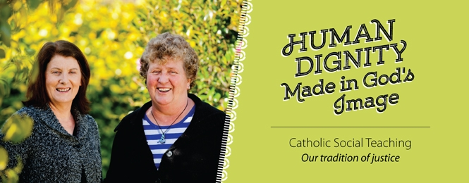
DIGNITY
“All people enjoy an equal dignity, all are loved by God.” – Pope Francis

Slide 4
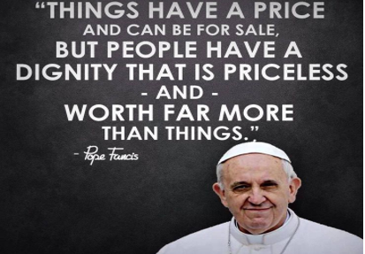
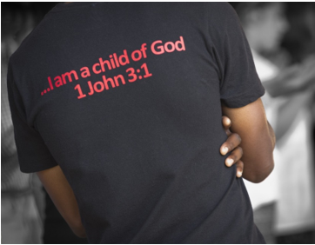
These are some of the ways in which we have highlighted the importance of Dignity:
Celebrate self-confidence and build self-esteem.
Opportunities to show respect to others
Include all in all activities
Consider communication needs and use AAC to enhance communication skills
Involving all children in conversation regardless of their ability to use language
Respect for privacy
Personal care/dressing/undressing
Involve children in decision making processes

Slide 5
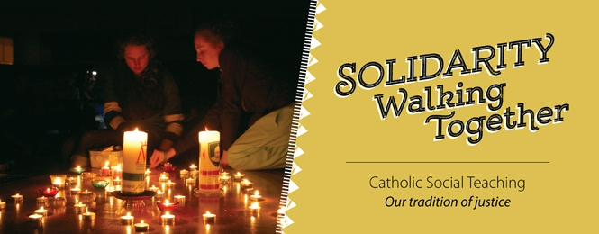
SOLIDARITY AND PEACE
“How many wars take place in our communities, even among Christians?” – Pope Francis

Slide 6
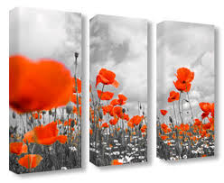
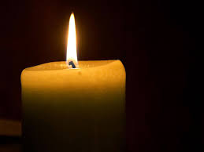



Slide 7
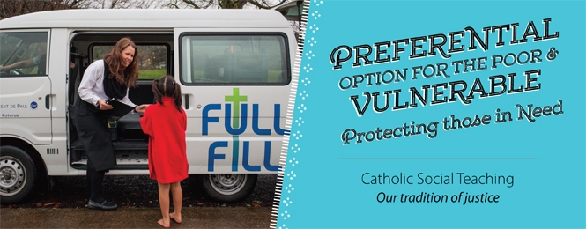
OPTION FOR THE POOR
“We’re called to find Christ in the poor, to lend our voice, to be their friends, to listen.” – Pope Francis

Slide 8

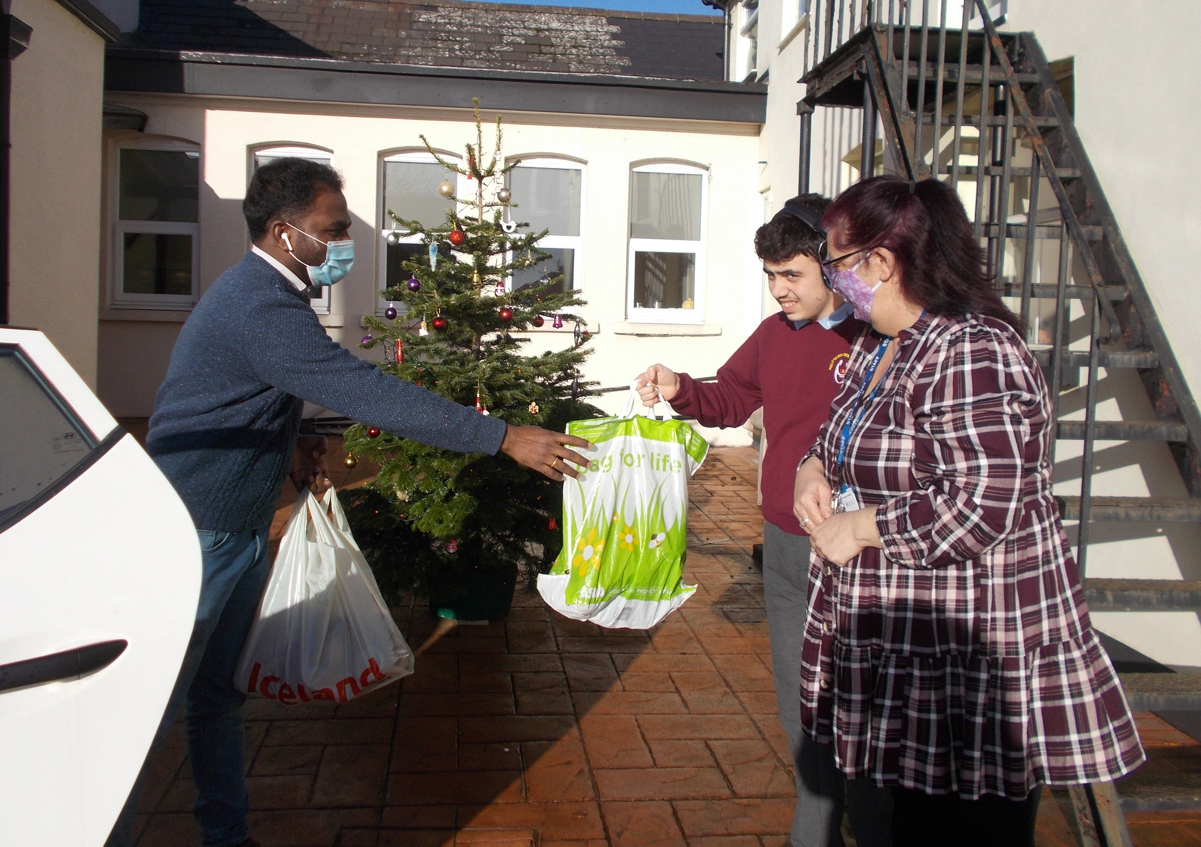
Following the events we had to mark Harvest Fast Day, we have continued to raise awareness of the work of CAFOD all over the world. This term we took part in their World Gifts Campaign and donated £50. The money was used to buy CAFOD World Gifts. We bought Water for a Family, Teach Someone to read, Keep Clean Kit.
3C held a reverse Advent Calendar to help the local food bank/parish with items they collected for Christmas. Aware that with the way things have been this year and how it is more important than ever to help out anyone who we can reach so with that in mind. Donations included; tinned food, dried food, packet food, Christmas decorations, small toiletry gift sets, small gifts for boys/girls, nice treats to make a difference to another family's joy at Christmas. Many thanks to Sarah Ball and her Class Team for organising this activity every year. This year the collection went to the The Immaculate Heart of Mary Parish Food Bank in Hayes.

Slide 9
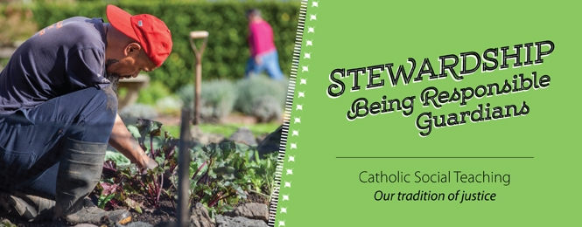
CARE OF CREATION
“We love this magnificent planet on which God has put us, and we love the human family” – Pope Francis

Slide 10
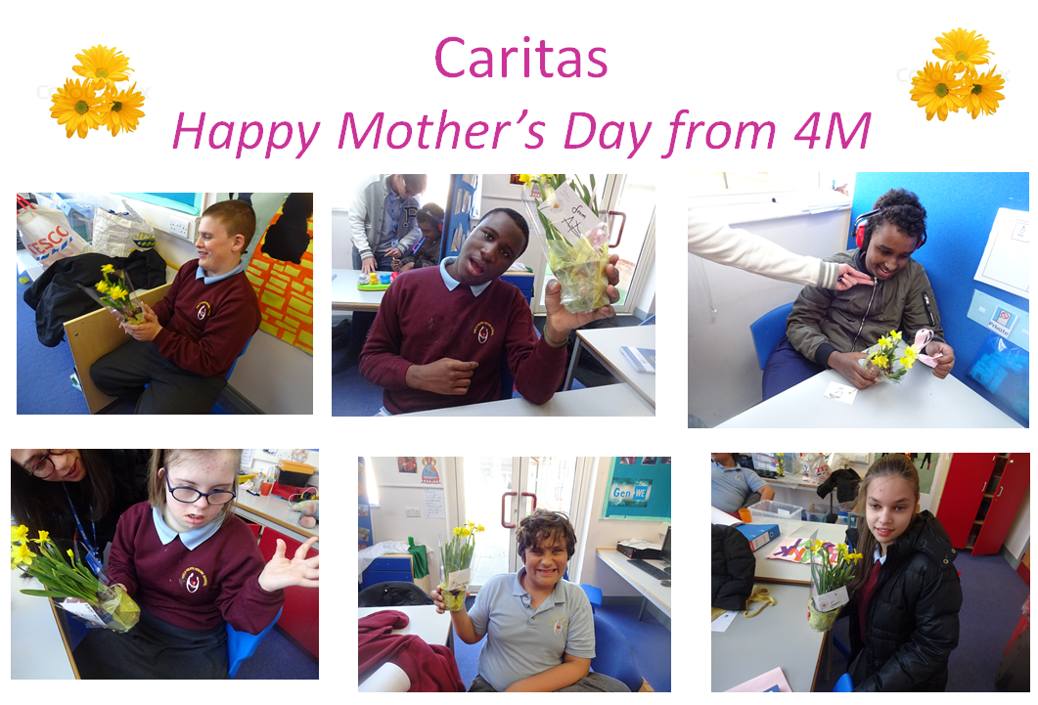

Slide 11
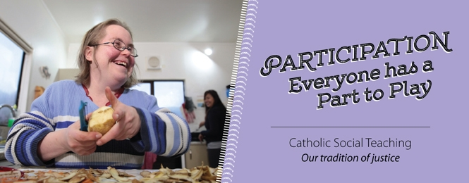
COMMUNITY AND PARTICIPATION
“Don’t be observers of life but get involved. Jesus did...” – Pope Francis

Slide 12

This term VBC B participated in raising money for Walk for Water. The students walked with 2 litre bottles filled with water to represent how people in other countries have to walk with water attached to their backs. They walked for an hour doing aps around the cycle track. We are really proud of their achievements!

Slide 13

DIGNITY OF WORKERS
“Work is fundamental, it ‘anoints’ us with dignity, makes us similar to God.” – Pope Francis

Slide 14
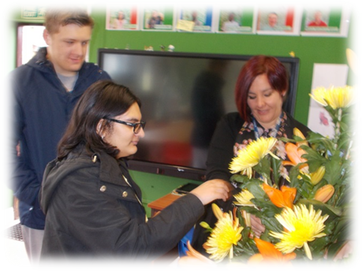
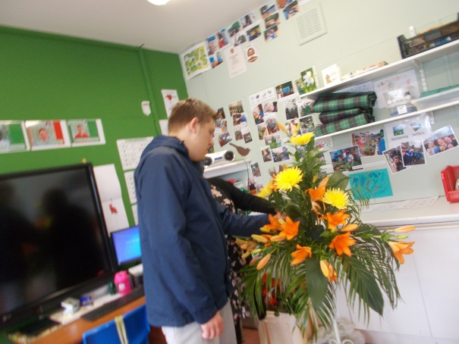
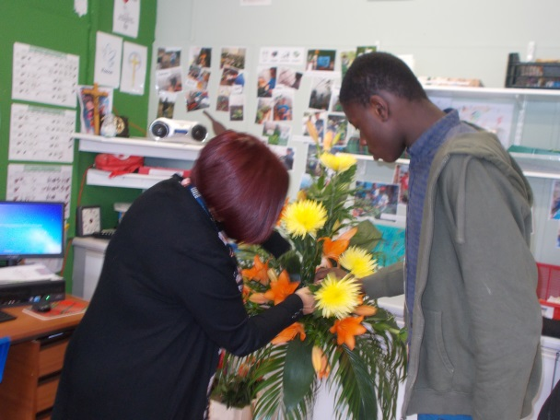
When our classmate Ernest had his Confirmation, the class worked together to create a beautiful floral arrangement for the Chapel.

