Slide 1


Who do
I meet in church?

Slide 2

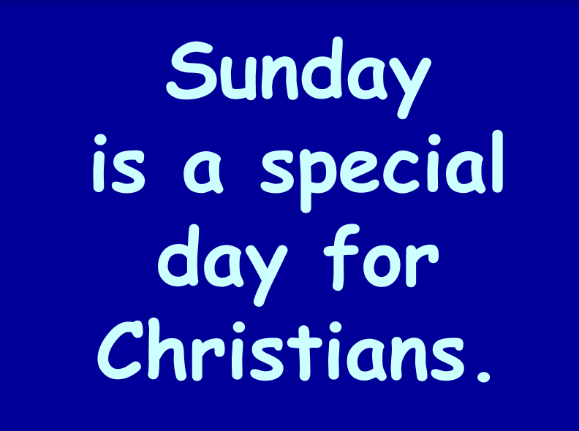


Slide 3

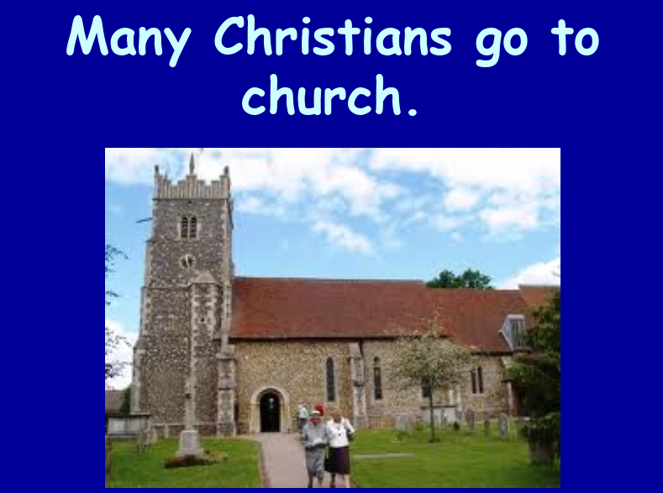


Slide 4




Slide 5
Who do
I meet in church?

Slide 6
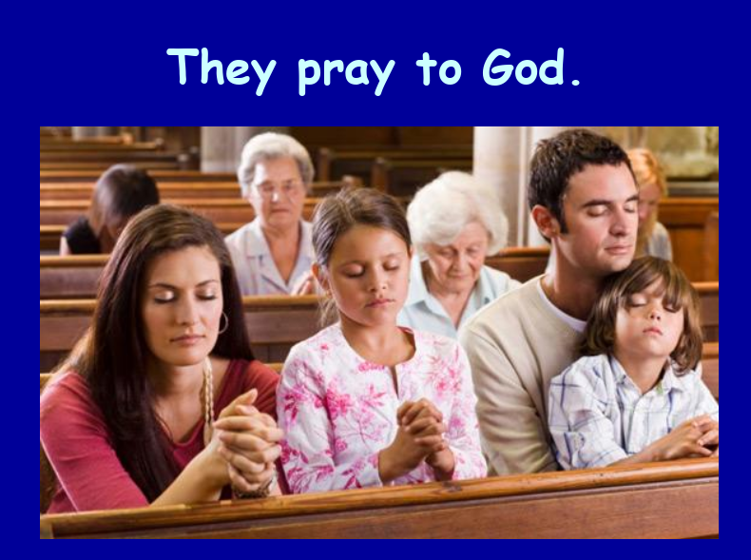
People who pray

Slide 7




Lectors who read

Slide 8
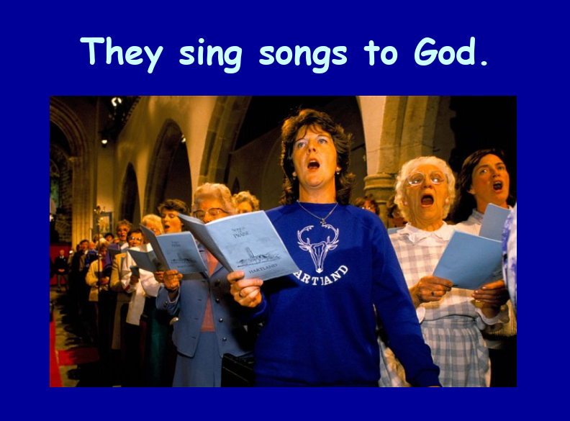


Singers who sing

Slide 9
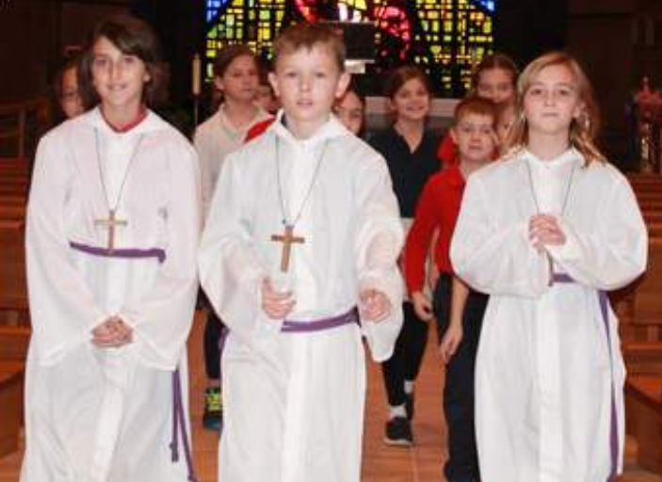


Altar servers who help

Slide 10

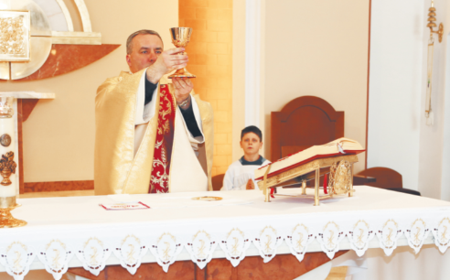


The Priest who celebrate the Mass

Slide 11
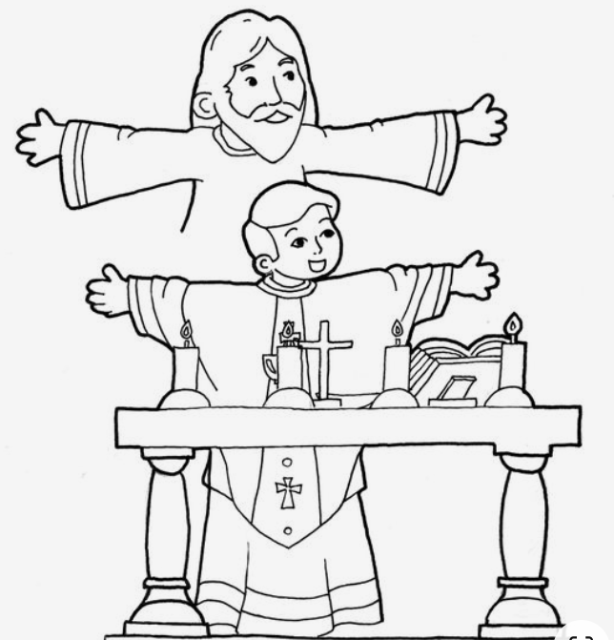

The Priest helps us to meet Jesus who we cannot see.

Slide 12
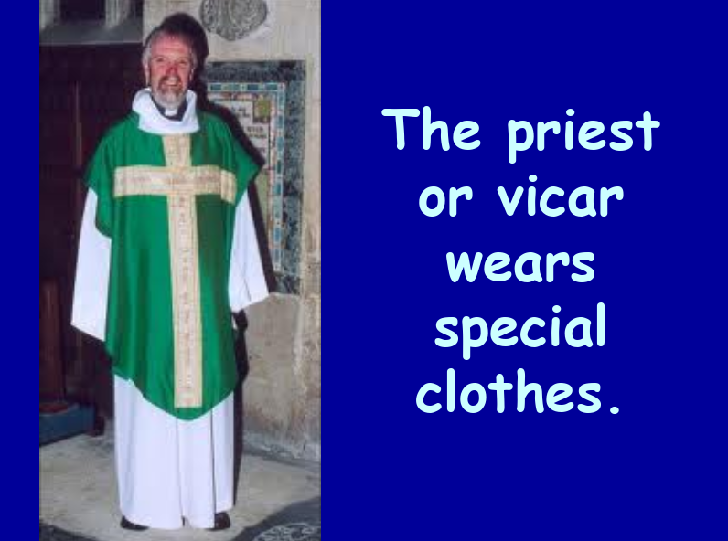


Slide 13
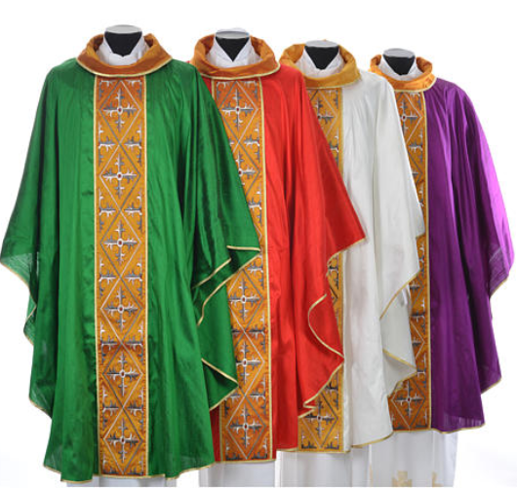
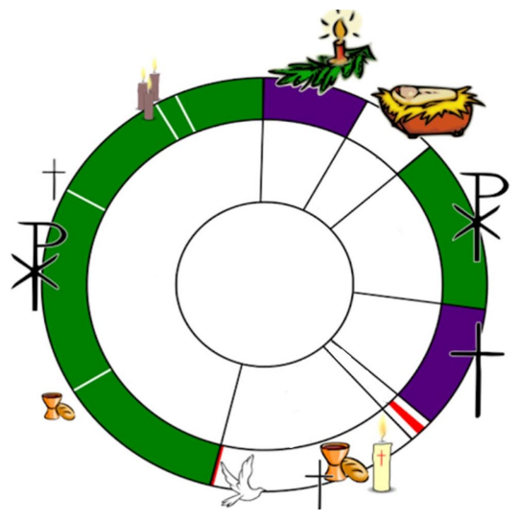

The priest wears different colours of “vestments” during the year.

Slide 14
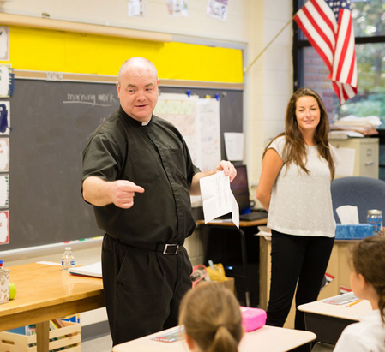

The priest
teaches about God

Slide 15
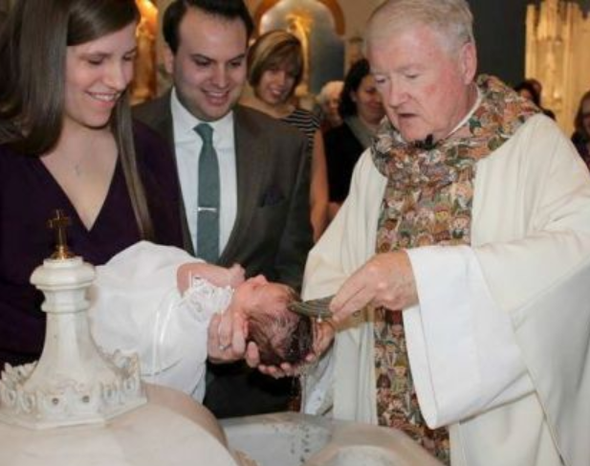


administers
the sacraments

Slide 16
celebrates Mass

Slide 17
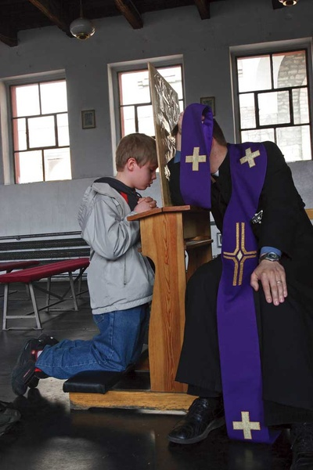
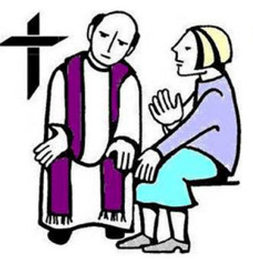
helps us to say Sorry to God

Slide 18
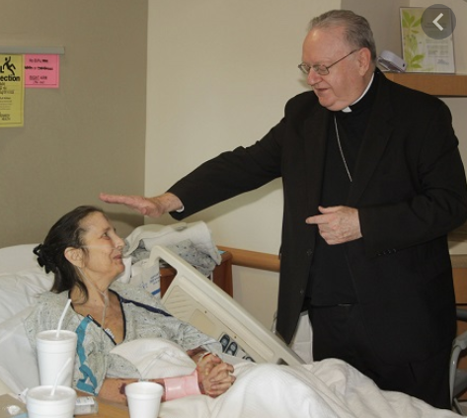

visits people who are ill

Slide 19

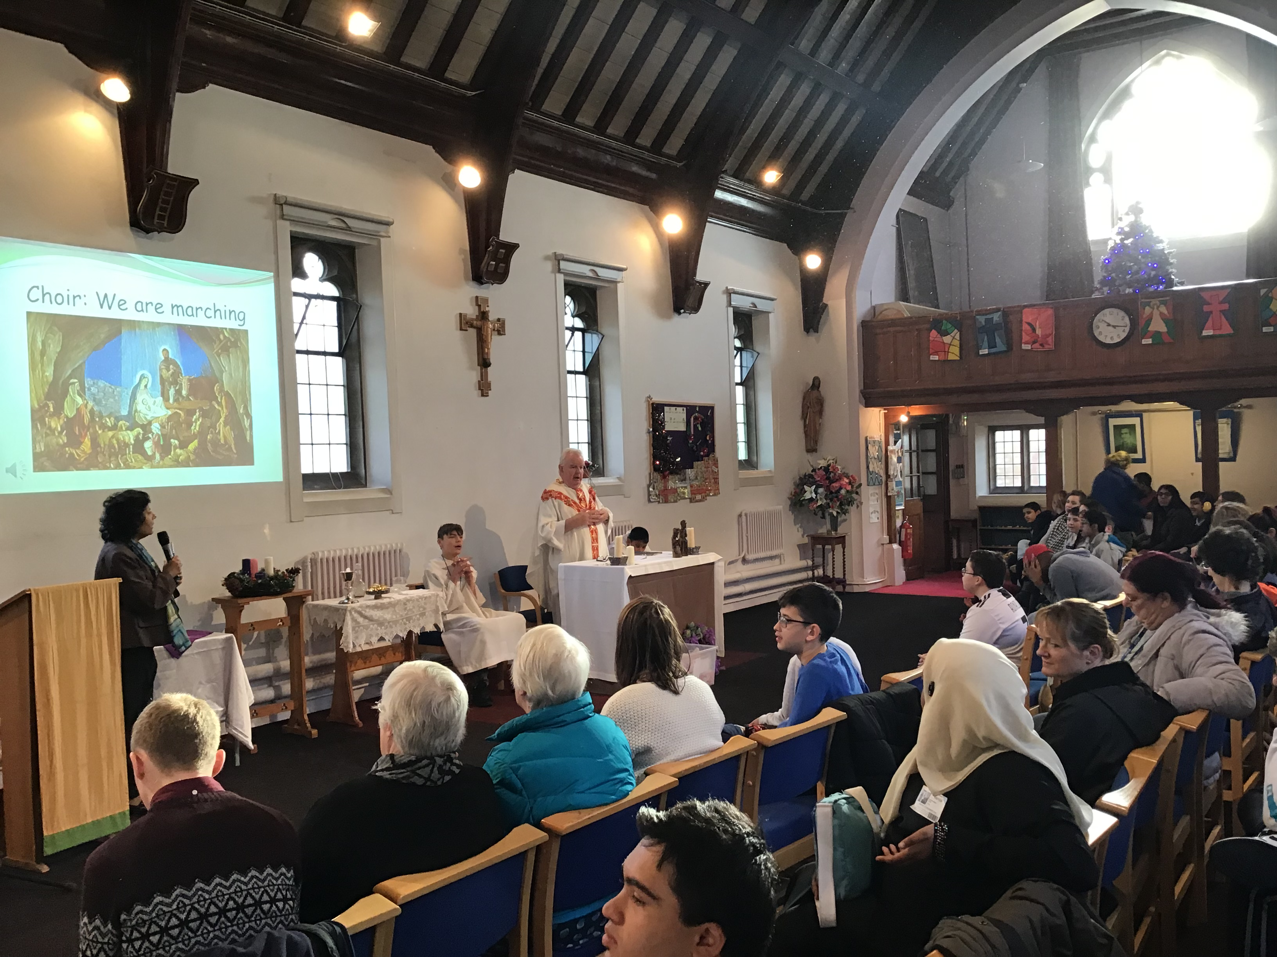


In our school chapel I can pray with my friends

Slide 20

Do you remember who we can meet in church?
Think and listen to church music.
https://youtu.be/QQBBpIGAFuU

